Slide 1
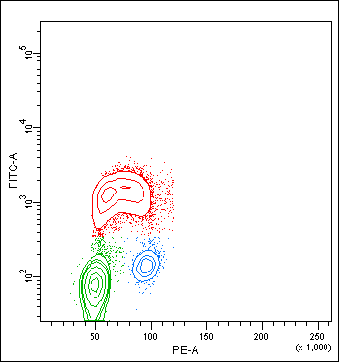
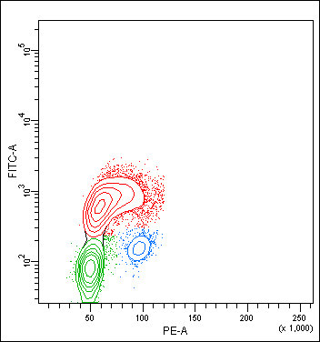
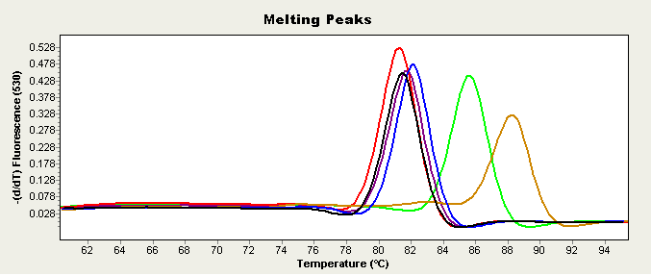
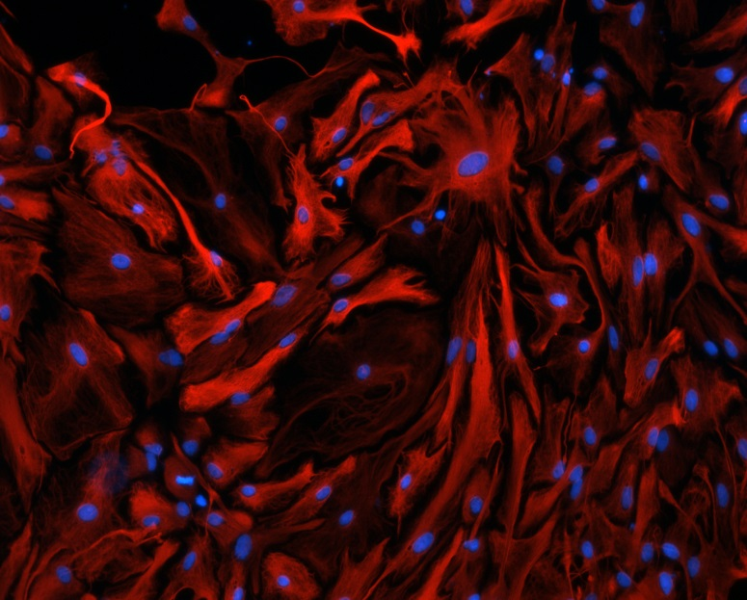

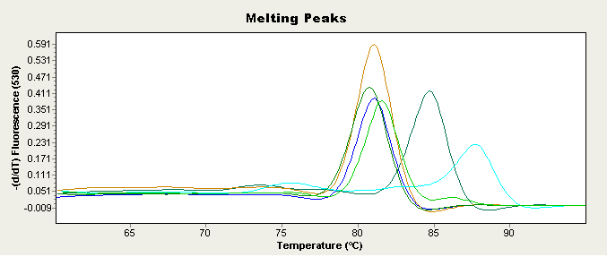

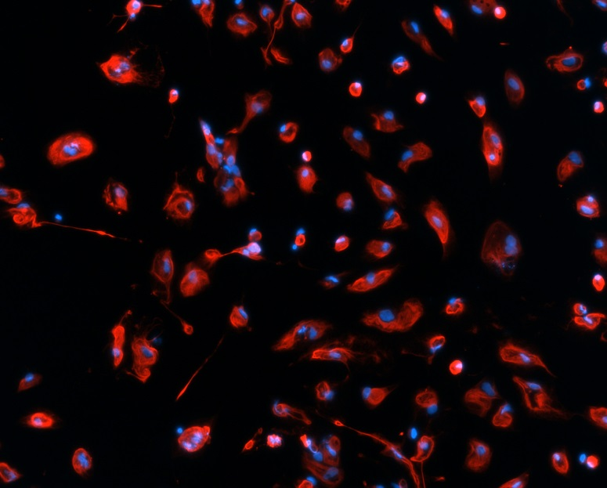
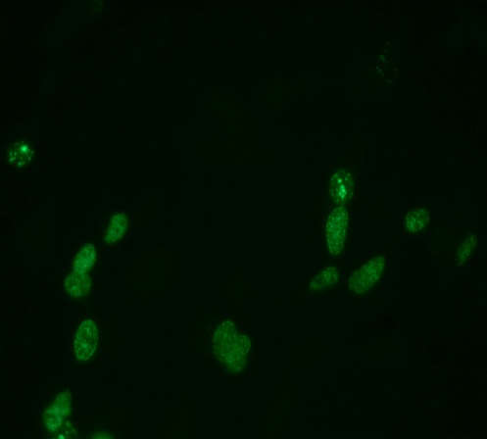
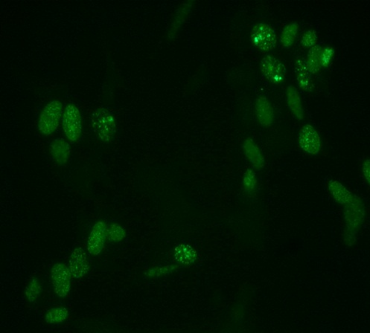
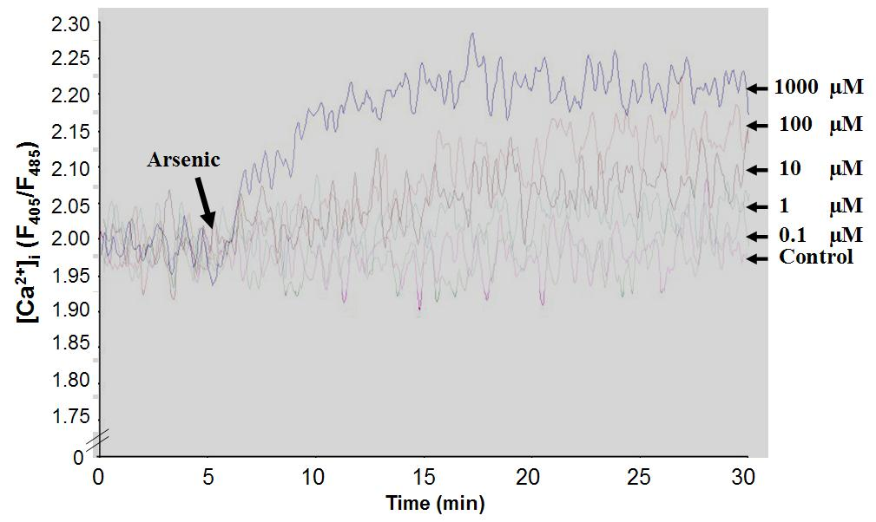
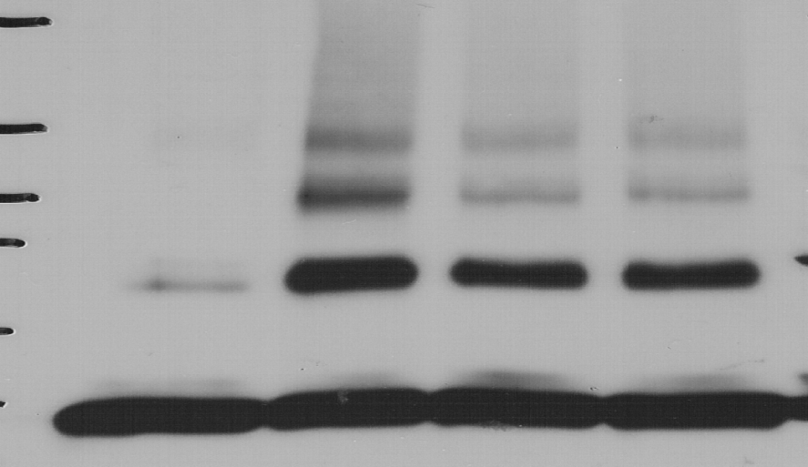
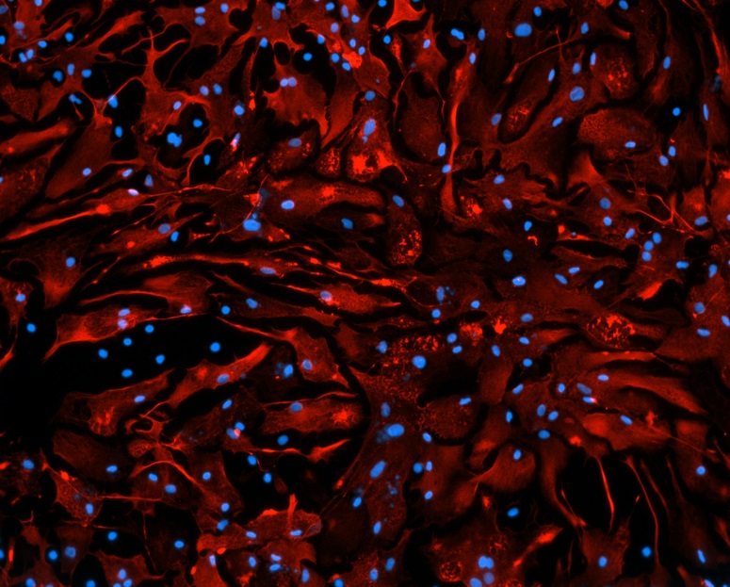
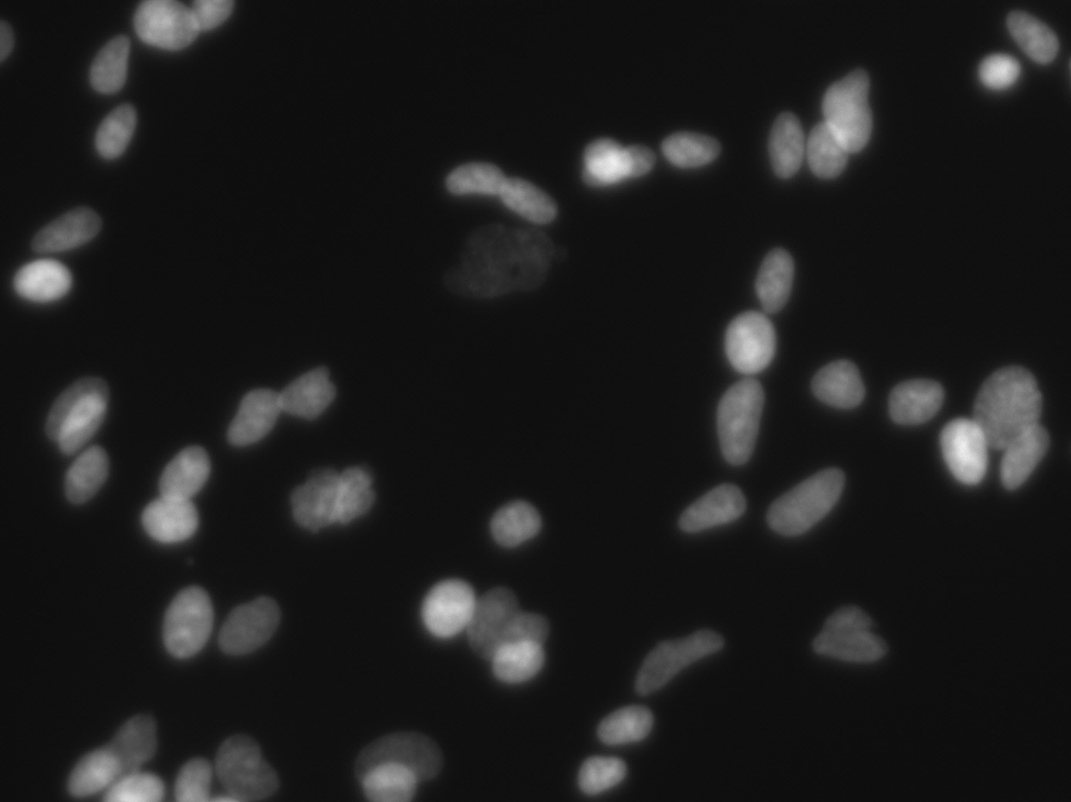
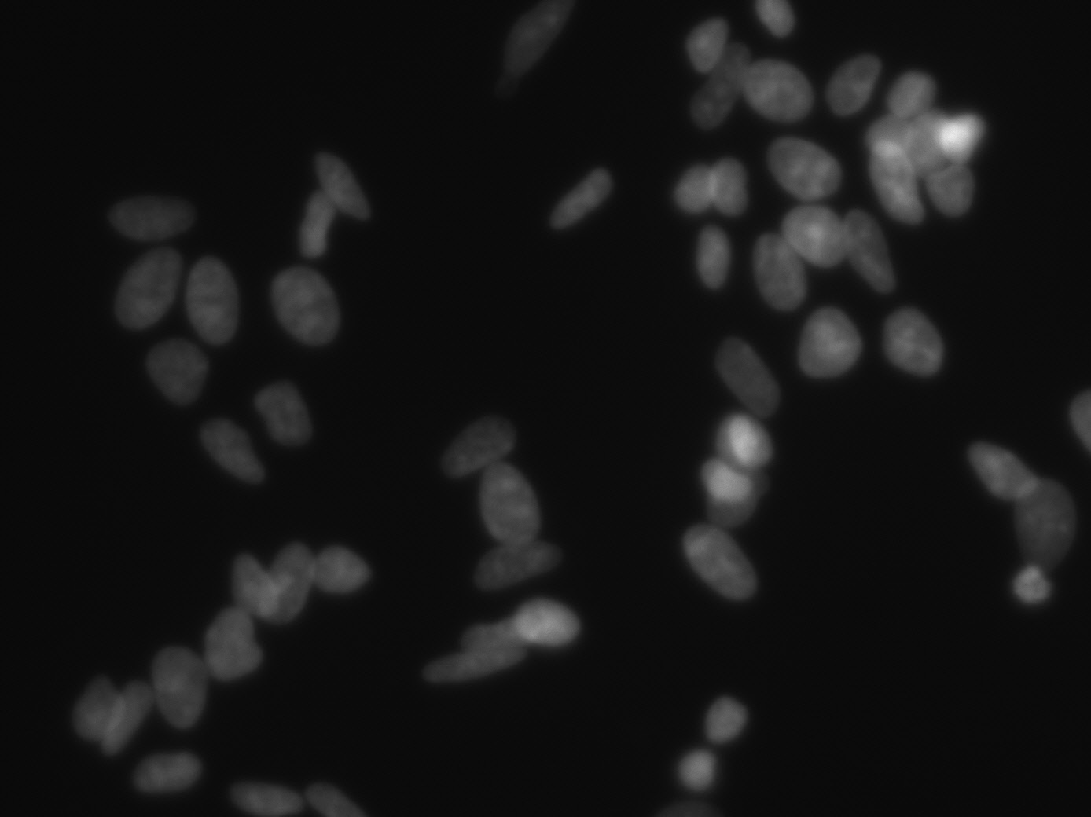
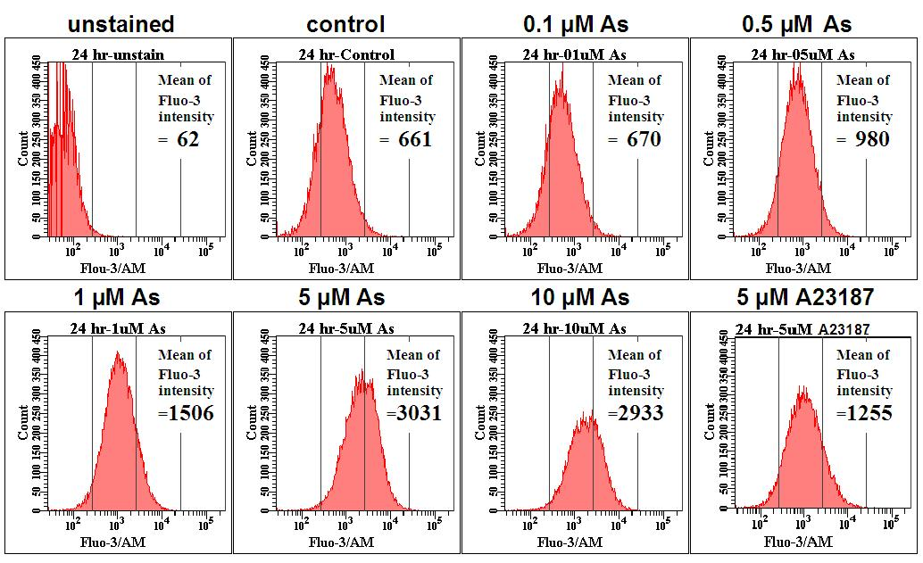
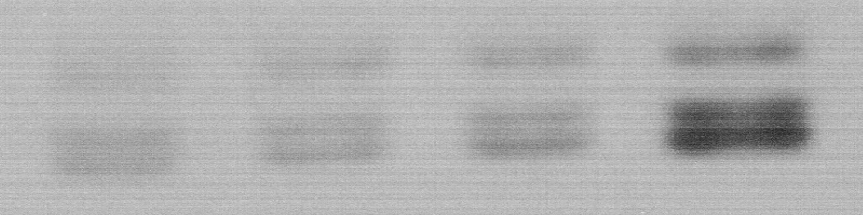
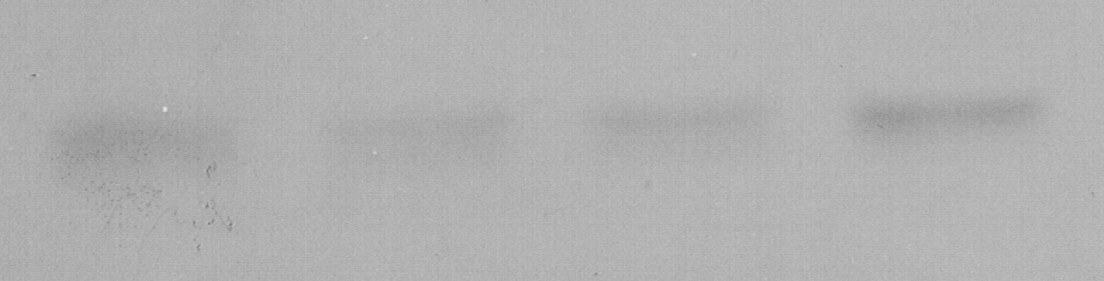
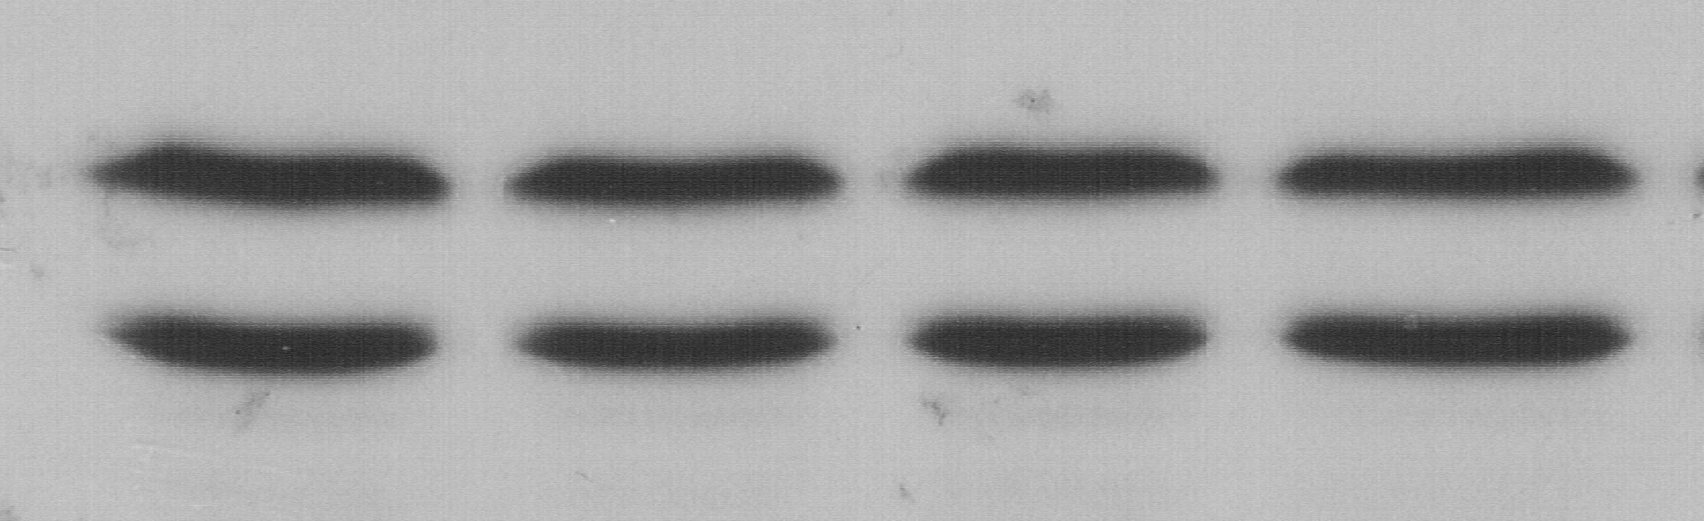
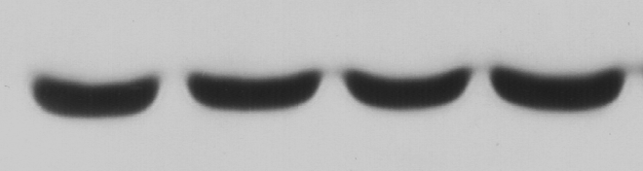
Primary rat astrocytes
Control
5 μM NaAsO₂ 24h
No treatment
S phase 32.10 + 0.93%
S phase 53.80 + 1.55%
189
S phase
165
VEGF
expression
S phase
121
GAPDH
20 µm
0 1 5 10 DFX
NaAsO₂ (μM)
50µM NaAsO₂
MW (kD)
175
EGS Cross-link
87
62
Bax Oligomer
47
32
25
Bax Monomer
As
-
+
+
+
50 µm
BrdU
Li
-
-
+
-
SB
-
-
-
+
1,000µM MnCl₂
pSer21 GSK3α
pSer9 GSK3β
pAkt
Akt
GSK3β
β-Actin
50 µm
Hoechst
As(μM) 0 0.1 1 10
Glial Fibrillary Acidic Protein (GFAP):
astrocytes biomarker
Sodium arsenite induced S-phase in SH-SY5Y cells (neuroblastoma cell line)
Arsenite-mediated intracellular free calcium levels [Ca²⁺]_{i} change in HMEC-1 cells.
Ca²⁺ indicator dye (Fluo-3/AM) were determined by flow cytometry.
Sodium arsenite inhibited GSK3 in SH-SY5Y cells
Cell nuclei

